Slide 1
ER(Emergency Room) Simulator
By: Kevin Luu - 300789868
Will Zhang - 300794888
Sangbeom (Sean) Yi - 300857600

Slide 2

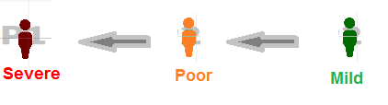
Premise
3-4 types of patients showed in different colors which present how badly they hurt or how sick they are.
Green to Yellow to Red.
Mild
Poor
Severe

Slide 3
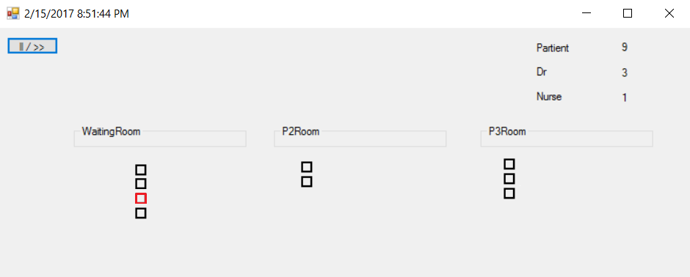
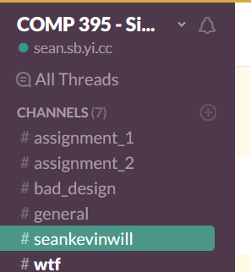
Work Process
Design Meeting
Making Prototype (less than half day)
Check a working task
Based on first presentation concept
Real Works ( Unity Version)
{ Making a To-Do list, communicate using a slack }

Slide 4
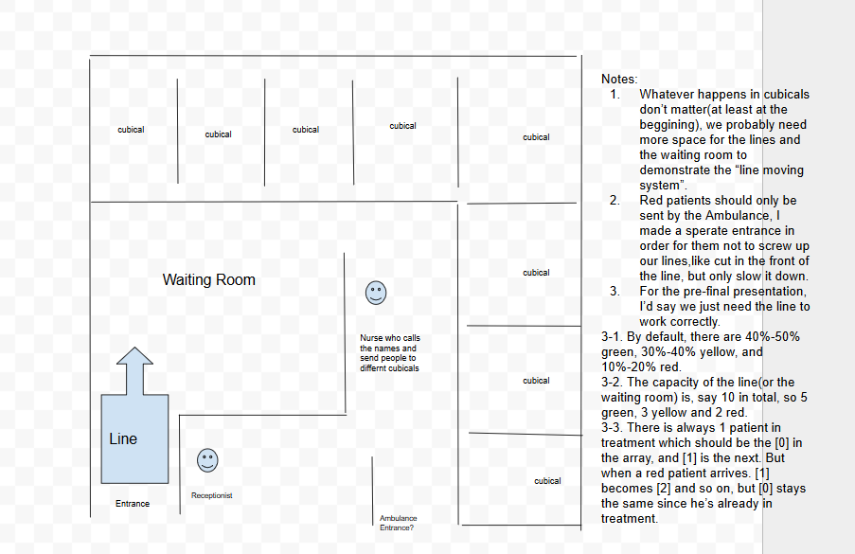
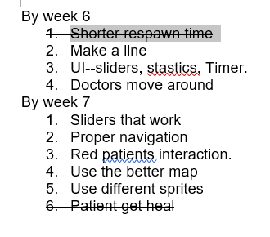
Documentation
Concept Drawing
To-Do List
Nurse

Slide 5

Demonstation

Slide 6
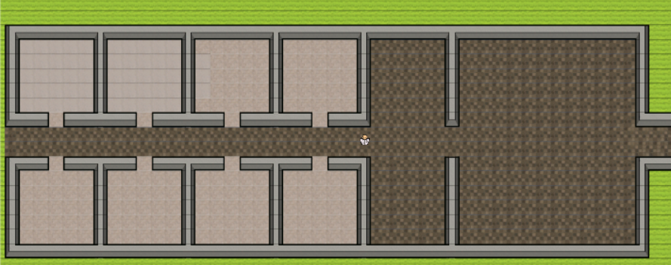

Next Step
Change the graphic:

Slide 7

Q & A
Thank you!

